Slide 1
Chapter 4 Computer Software
James A. O'Brien, and George Marakas. Management Information Systems with MISource 2007, 8th ed. Boston, MA: McGraw-Hill, Inc., 2007. ISBN: 13 9780073323091

Slide 2
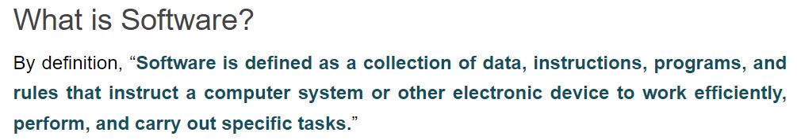
Lecture-2: Computer Software

Slide 3
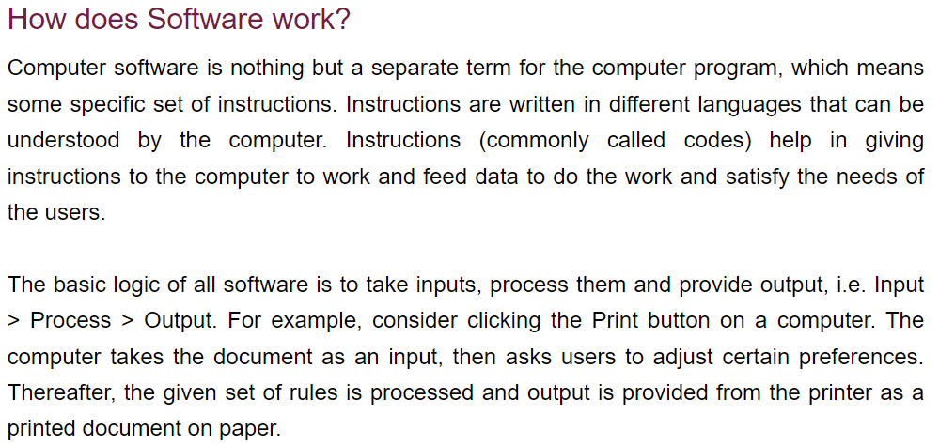
Lecture-2: Computer Software

Slide 4
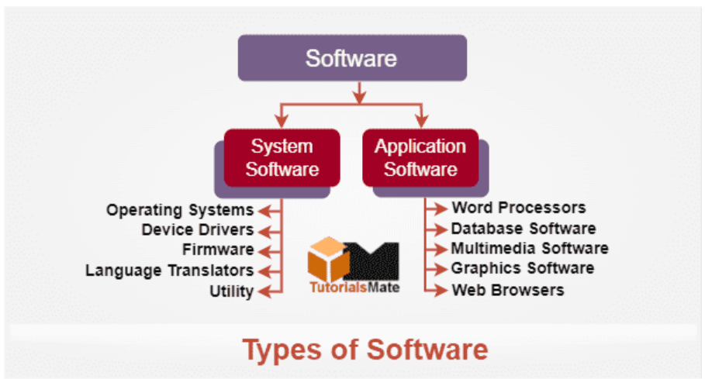
Lecture-2: Computer Software

Slide 5
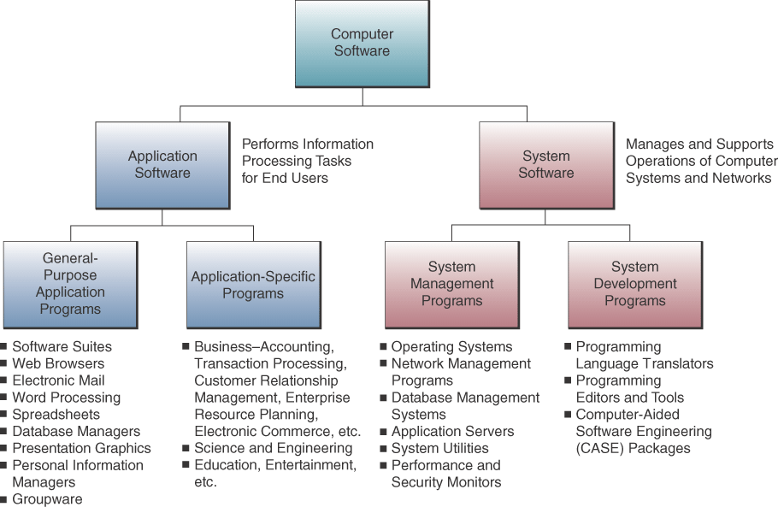
Types of Application & System Software
Lecture-2: Computer Software

Slide 6
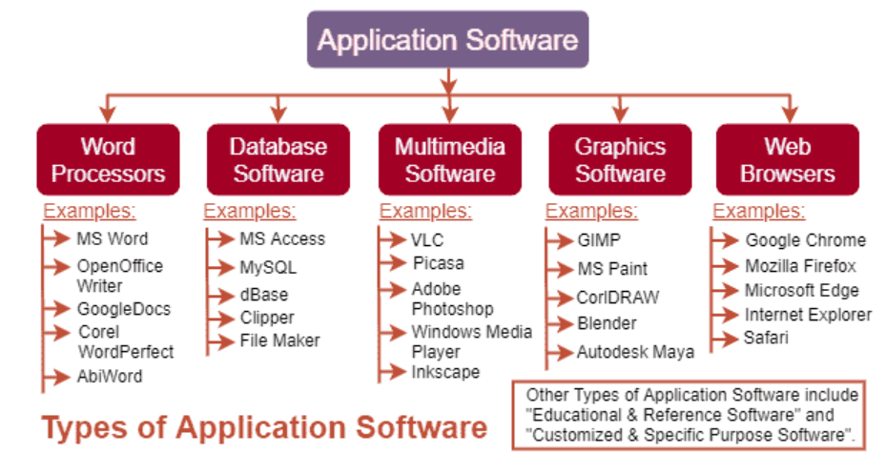
Lecture-2: Computer Software

Slide 7
Application Software
General Purpose
  Programs that perform common information processing jobs for end users; e.g., word processing, spreadsheet
  Also call productivity packages
Custom Software
  Software applications developed within an organization for use by that organization
Commercial Off-the-Shelf (COTS)
  Many copies sold
  Minimal changes beyond scheduled upgrades
  Purchasers have no control over specifications, schedule, or evolution, and no access to source code or internal documentation
  Product vendor retains the intellectual property rights of the software
Lecture-2: Computer Software

Slide 8
Application Software
Open-source Software
  Developers collaborate on the development of an application using programming standards which allow anyone to contribute to the software
  As each developer completes a project, the application code becomes available and free to anyone who wants it
Lecture-2: Computer Software

Slide 9
Business Application Software
Function-Specific Application Software
  Thousands of these packages support specific applications of end users
  Examples: customer relationship management, enterprise resource planning, supply chain management, Web-enabled electronic commerce
Lecture-2: Computer Software

Slide 10
Software Suites, Integrated Packages
Most widely used productivity packages are bundled together as software suites
Advantages
  Cost less than buying individual packages
  All have similar GUI
  Work well together
Disadvantages
  All features not used
  Takes a lot of disk space (bloatware)
Lecture-2: Computer Software

Slide 11
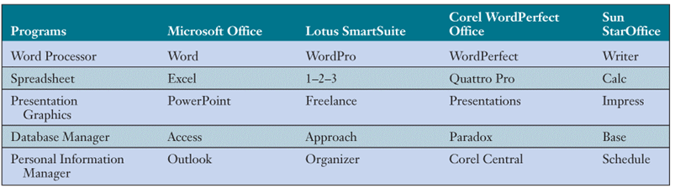
Components of Top Software Suites
Lecture-2: Computer Software

Slide 12
Integrated Packages
Integrated packages combine the functions of several programs into one package
  E.g., Microsoft Works, AppleWorks
Advantages
  Many functions for lower price
  Uses less disk space
  Frequently pre-installed on microcomputers
Disadvantages
  Limited functionality
Lecture-2: Computer Software

Slide 13
Web Browsers
Software applications that support navigation through the point-and-click hyper-linked resources of the Web
Becoming the universal platform from which end users launch…
  Information searches
  E-mail
  Multimedia file transfer
  Discussion groups
  Other Internet-based applications
Lecture-2: Computer Software

Slide 14
Search Engines
Browsers are used to gain access to Internet search engines
  Google, Ask Jeeves, Look Smart, Lycos, Overture, Yahoo!
Using search engines to find information has become an indispensable part of Internet, intranet, and extranet applications
Lecture-2: Computer Software

Slide 15
E-mail, Instant Messaging, and Weblogs
E-mail
  Software to communicate by sending and receiving messages and attachments via the Internet, intranet, or extranet
Instant messaging (IM)
  Receive electronic messages instantly
Weblog or blog
  A personal website in dated log format
  Updated with new information about a subject or range of subjects
Lecture-2: Computer Software

Slide 16
Word Processing/Desktop Publishing
Word Processing
  Create, edit, revise, and print documents
  Example: Microsoft Word, Lotus WordPro, Corel WordPerfect
Desktop Publishing
  Produce printed materials that look professionally published
  Example: Adobe PageMaker, Microsoft Publisher, QuarkXPress
Lecture-2: Computer Software

Slide 17
Electronic Spreadsheets
Used by virtually every business for…
  Analysis, planning, modeling
Electronic Spreadsheet
  Worksheet of rows and columns
  Can be stored on local computer or on network
  Requires designing format and developing the relationships (formulas)
  Most help you develop charts and graphic displays of spreadsheet results
  Supports what-if questions
Lecture-2: Computer Software

Slide 18
Presentation Graphics
Common presentation graphics packages…
  Converts numeric data into graphics displays
  Used to create multimedia presentations of graphics, photos, animation, and video clips
  E.g., Microsoft PowerPoint, Lotus Freelance, Corel Presentations
  Top packages can tailor files for transfer in HTML format to websites
Lecture-2: Computer Software

Slide 19
Personal Information Managers
Software for end user productivity and collaboration
  Stores information about clients
  Manages schedules, appointments, tasks
  Most include ability to access the Web and provide e-mail capabilities
  Some support team collaboration by sharing information with other PIM users
  Example: Lotus Organizer, Microsoft Outlook
Lecture-2: Computer Software

Slide 20
Groupware
Software that helps workgroups collaborate on group assignments
  E-mail, discussion groups, databases, video conferencing
  Example: Lotus Notes, Novell GroupWise, Microsoft Exchange
  Windows SharePoint Services and WebSphere both allow teams to create websites for information sharing and document collaboration
Lecture-2: Computer Software

Slide 21
Software Alternatives
Outsourcing development and maintenance of software
Application service providers (ASPs)
  Companies that own, operate, and maintain application software and computer system resources
  Use the application for a fee over the Internet
  Pay-as-you-go
  Use expected to accelerate in the coming years
Lecture-2: Computer Software

Slide 22
Software Licensing
All COTS and ASP software is licensed
  Involves the underlying..
    Intellectual property rights
    Copyright
    Trademark
    Trade secrets
  Also involves traditional contract law, including Uniform Commercial Code (UCC)
You don’t buy software
  You buy a license to use the software
  Licensed to protect the vendor’s property rights
Lecture-2: Computer Software

Slide 23
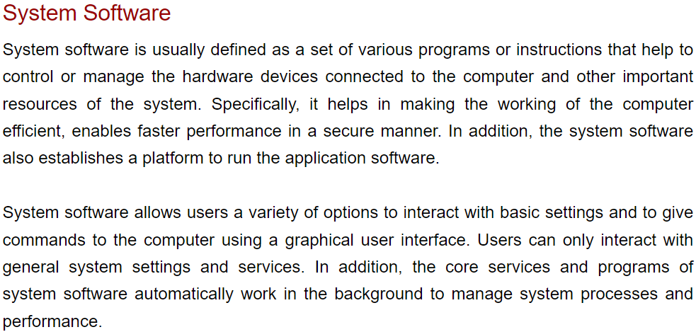
Lecture-2: Computer Software

Slide 24
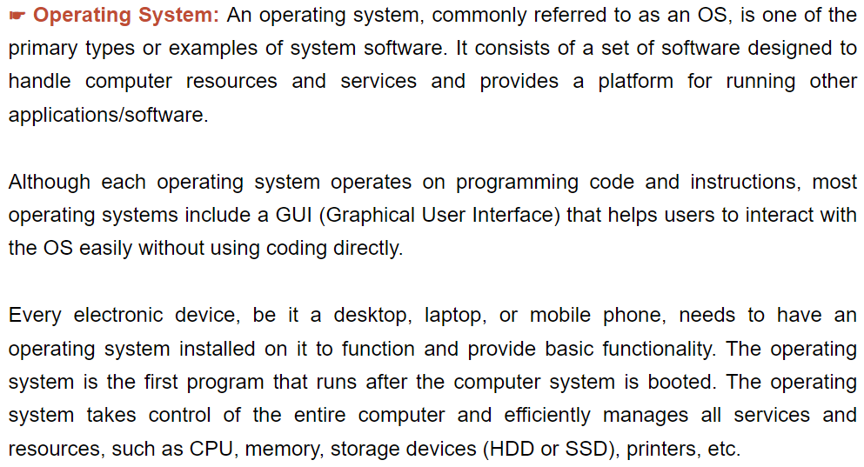
Lecture-2: Computer Software

Slide 25
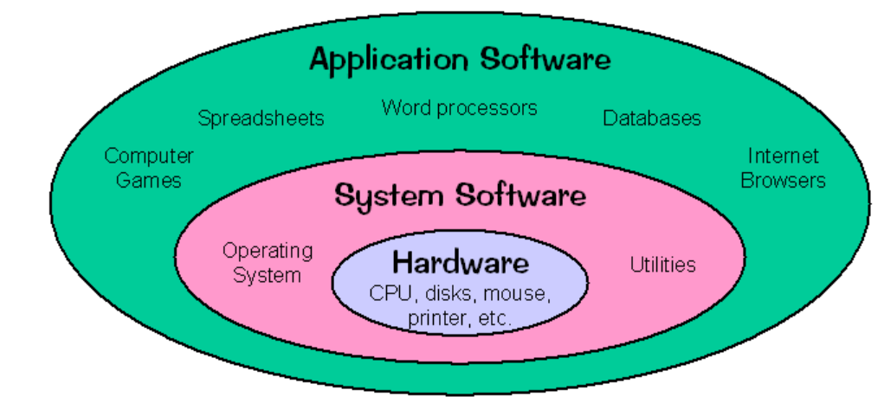
Lecture-2: Computer Software

Slide 26
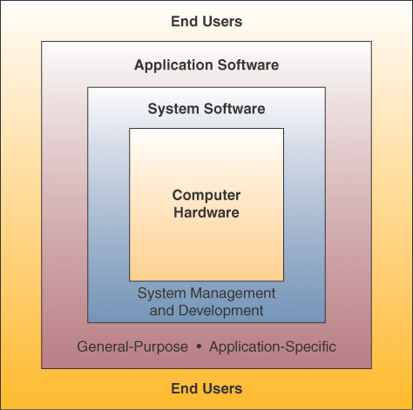
Interface Between End Users and Computer
Lecture-2: Computer Software

Slide 27
Operating Systems
Integrated system of programs that…
  Manages the operations of the CPU
  Controls the input/output, storage resources,
  and activities of the computer system
  Provides support services as the computer executes application programs
The operating system must be loaded and activated before other tasks can be accomplished
Lecture-2: Computer Software

Slide 28
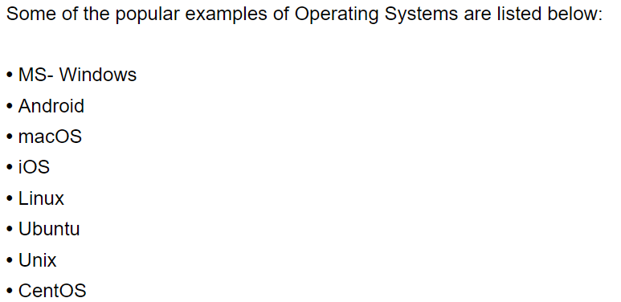
Lecture-2: Computer Software

Slide 29
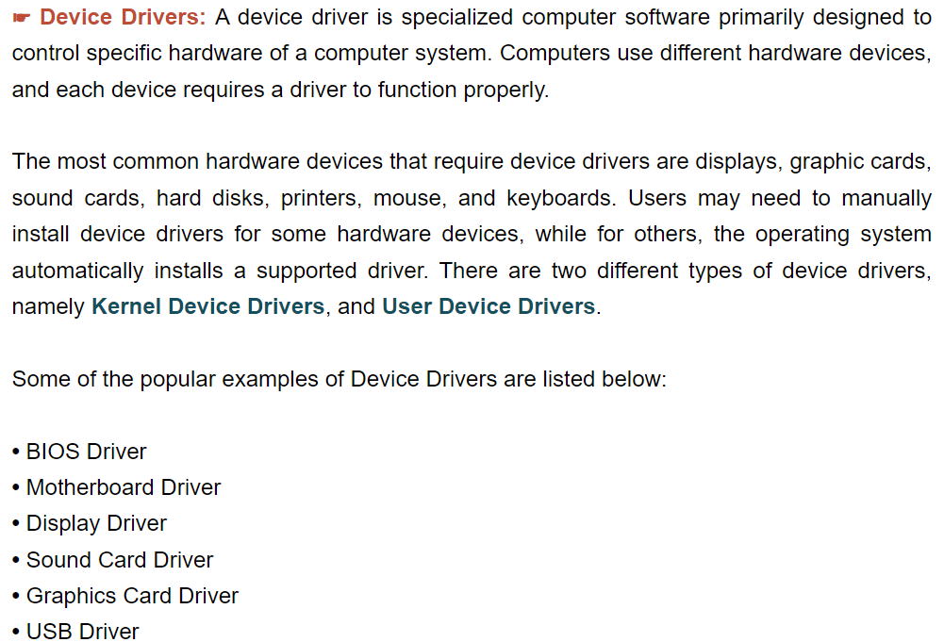
Lecture-2: Computer Software

Slide 30
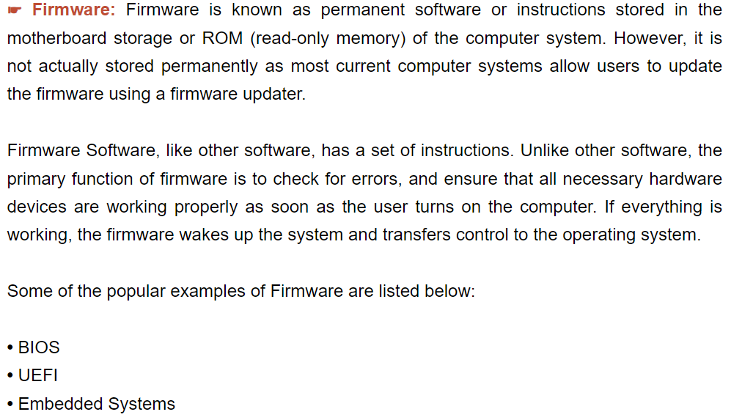
Lecture-2: Computer Software

Slide 31
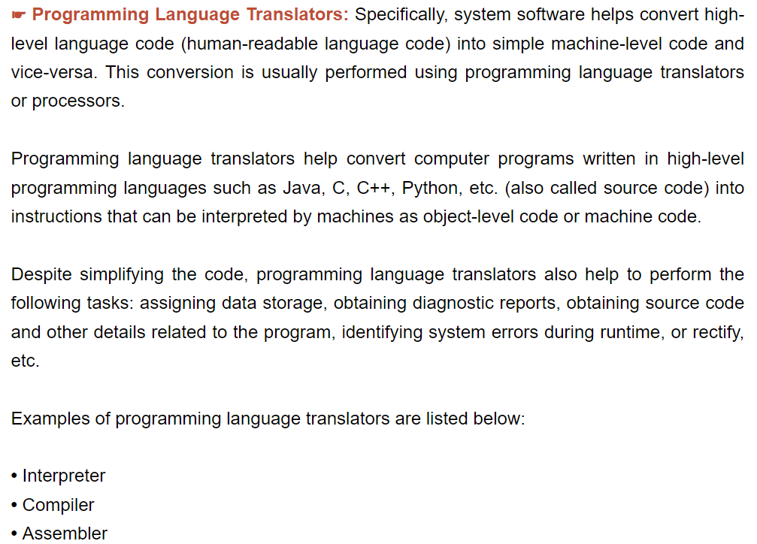
Lecture-2: Computer Software

Slide 32
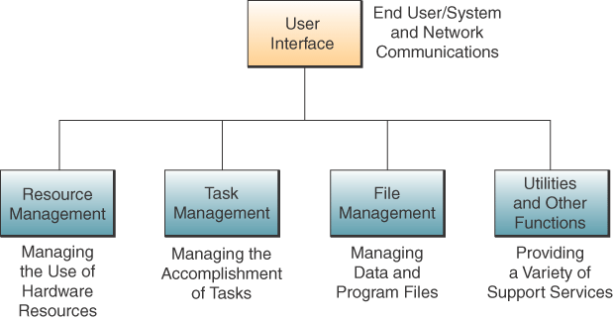
Operating System Basic Functions
Lecture-2: Computer Software

Slide 33
User Interface
The part of the operating system that allows you to communicate with it
Three main types…
  Command-driven
  Menu-driven
  Graphical user interfaces (GUI)
Lecture-2: Computer Software

Slide 34
Resource Management
Part of the operating system that manages the hardware and networking resources of a computer system
  Includes CPU, memory, secondary storage devices, telecommunications, and input/output peripherals
Common functions
  Keeping track of where data and programs are stored
  Subdividing memory; providing virtual memory capability
Lecture-2: Computer Software

Slide 35
File Management
Part of the operating system that controls the creation, deletion, and access of files and programs
  Keeps track of physical location on storage devices
  Maintains directories of information about the location and characteristics of stored files
Lecture-2: Computer Software

Slide 36
Task Management
Part of the operating system that manages the accomplishment of end user computing tasks
  Controls which task gets access to the CPU,
  and for how long
  Can interrupt the CPU at any time to substitute a higher priority task
  Supports preemptive and cooperative multi-tasking and multi-processing
Lecture-2: Computer Software

Slide 37
Popular Operating Systems
Windows
  GUI, multitasking, networking, multimedia
  Microsoft’s operating system
  NT, XP, 2003
  Different versions manage servers
Unix
  Multitasking, multi-user, network-managing
  Portable - can run on mainframes, midrange,
  and PCs
Linux
  Low-cost, powerful reliable Unix-like
  operating system
  Open-source
MAC OS X
  Apple operating system for the iMac
  GUI
  Multitasking
  Multimedia
Lecture-2: Computer Software

Slide 38
Open-Source Licensing Characteristics
The Program
  Must include source code and allow distribution in source code as well as compiled form
The License
  Shall not restrict any party from selling or giving away the software as a component of an aggregate software distribution containing programs from several sources
  Must allow modifications and derived works, and must allow them to be distributed under the same terms as the license of the original software
Lecture-2: Computer Software

Slide 39
Open-Source Licensing Characteristics
The License (cont’d)
  Must allow modifications and derived works and allow them to be distributed under the same terms as the license of the original software
  May restrict source code from being distributed in modified form only if the license allows the distribution of patch files with the source code
  for the purpose of modifying the program at build time
  Must not discriminate against any person or any group of persons
Lecture-2: Computer Software

Slide 40
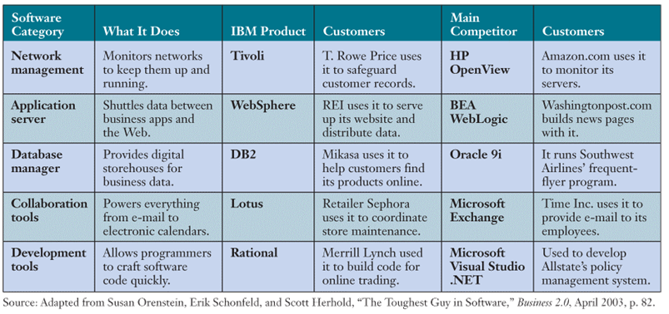
Other System Management Programs
Lecture-2: Computer Software

Slide 41
Application Servers
Provide an interface between an operating system and the application programs of users
Middleware
  Software that helps diverse software applications exchange data and work together more efficiently
Lecture-2: Computer Software

Slide 42
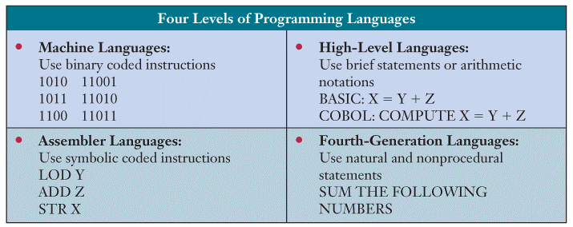
Programming Languages
Examples of programming in each language
Lecture-2: Computer Software

Slide 43
Web Languages
HTML
  A page description language that creates hypertext documents for the Web
XML
  Describes Web page content by applying identifying tags or contextual labels to the data
Java
  Object-oriented programming language that is simple, secure, and platform independent
  Java applets can be executed on any computer
Lecture-2: Computer Software

Slide 44
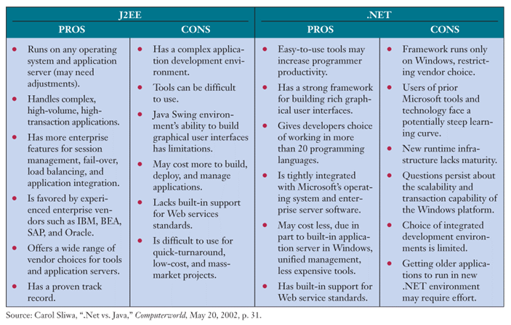
J2EE versus .Net
Lecture-2: Computer Software

Slide 45
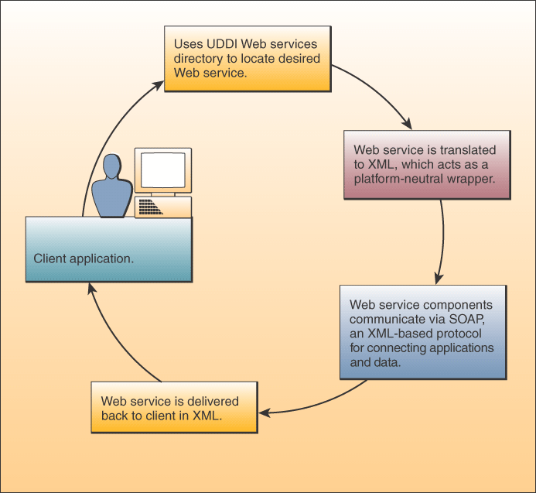
Web Services
How Web Services Work
Web services are software components that are
  Based on framework of Web and object-oriented standards and technology
  Used to link the applications of different users and computing platforms via the Web
Lecture-2: Computer Software

Slide 46
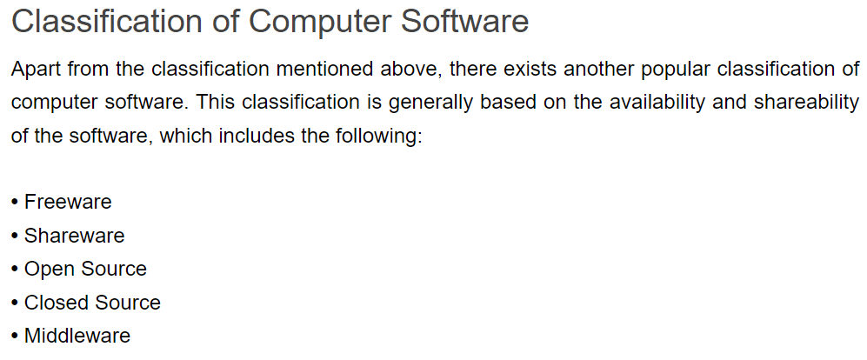
Lecture-2: Computer Software

Slide 47
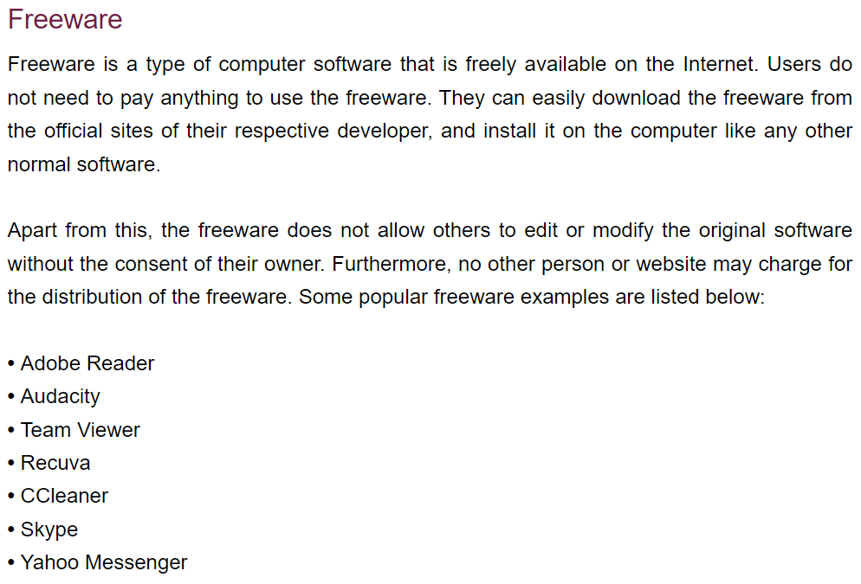
Lecture-2: Computer Software

Slide 48
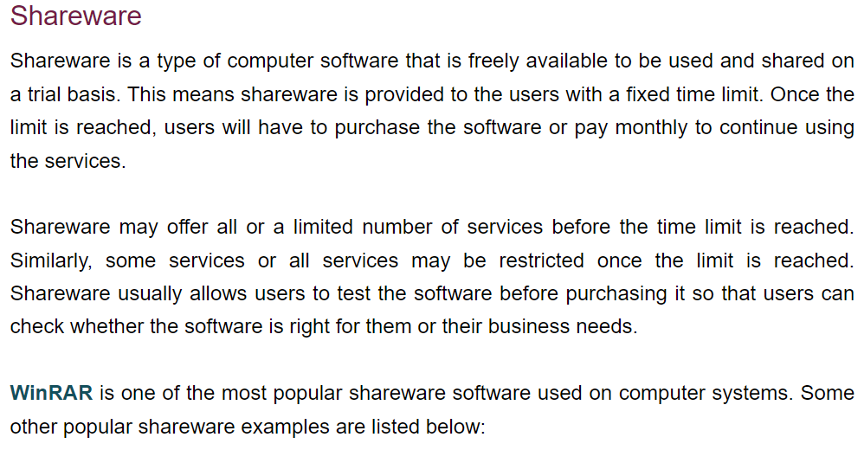
Lecture-2: Computer Software

Slide 49
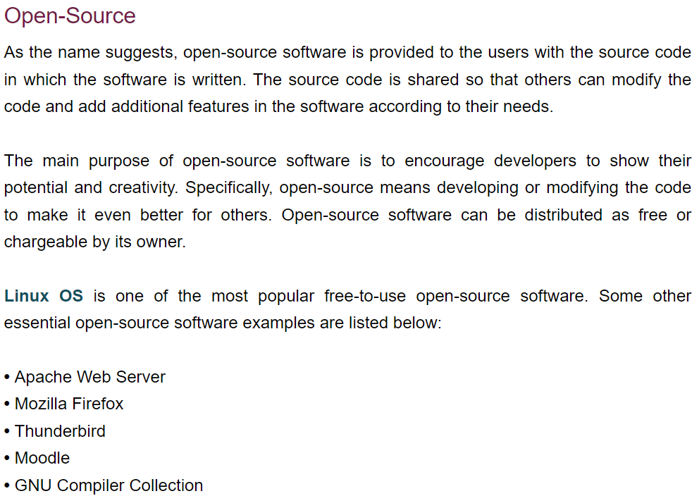
Lecture-2: Computer Software

Slide 50
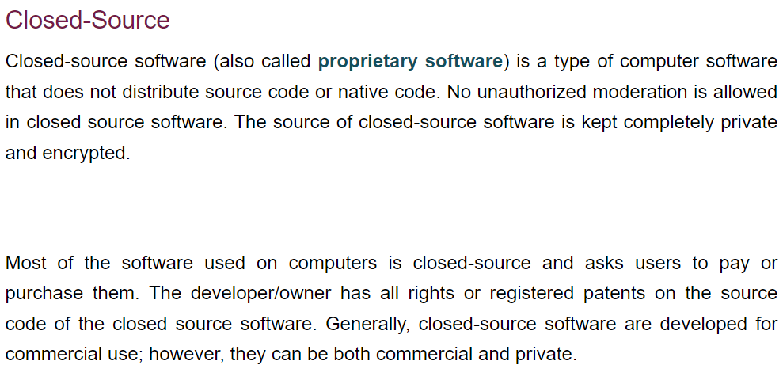
Lecture-2: Computer Software

Slide 51

Fastest Super Computer
Lecture-2: Computer Software

Slide 52
Lecture-2: Computer Software

